Slide 1
Dissociative recombination of H₃⁺ - ten years in retrospect
(H₃⁺ + e → 3H)
Mats Larsson
Stockholm University

Slide 2
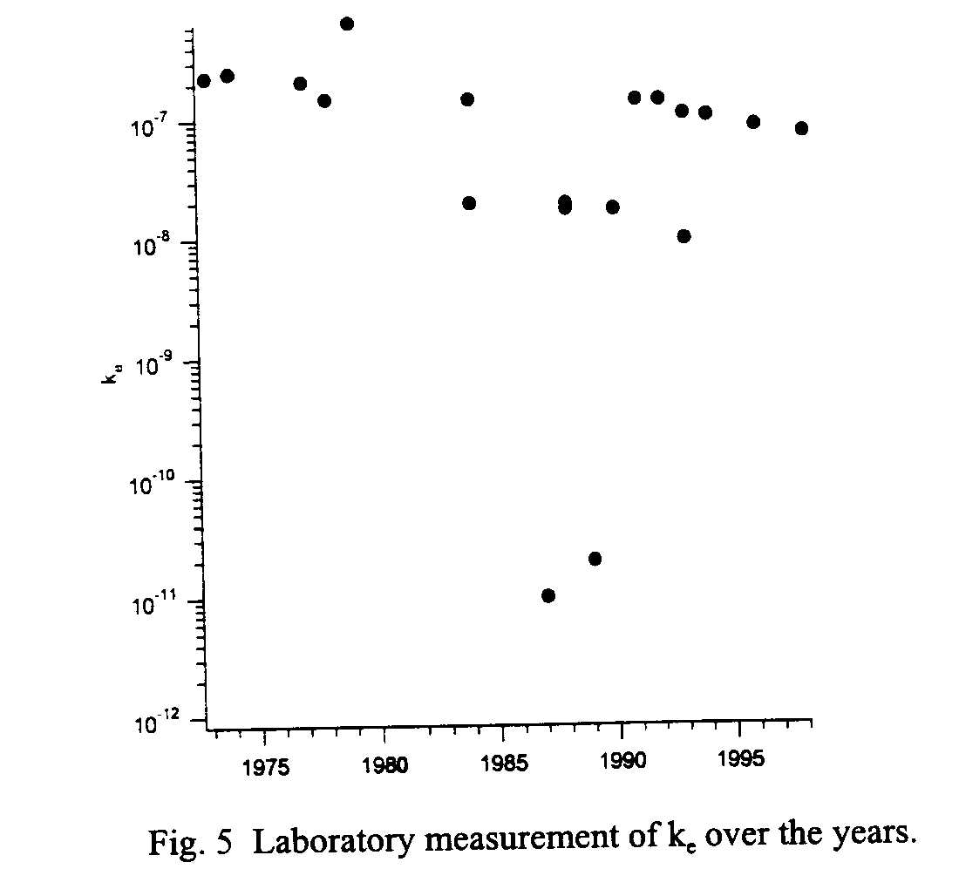
Oka 1999

Slide 3
Outline
The 2001 year crisis
The clouds are dispersing
Outstanding questions
Outlook

Slide 4
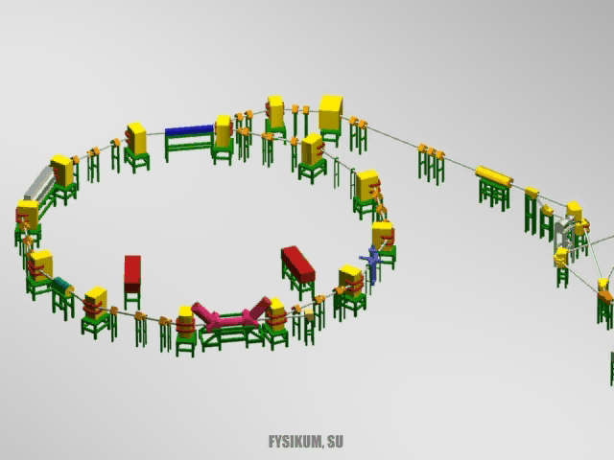

Slide 5
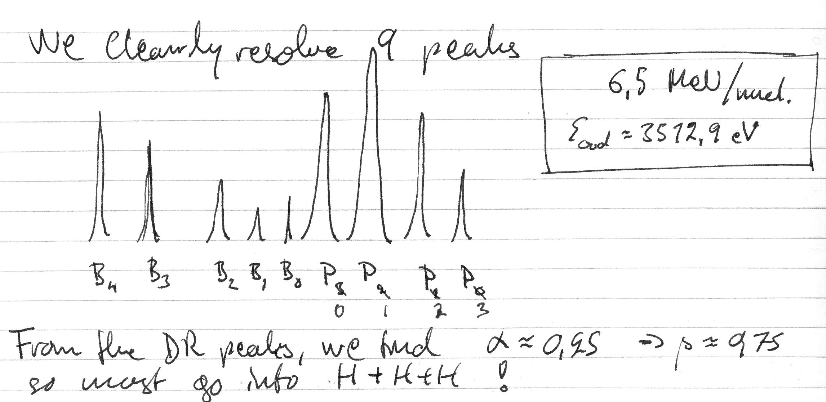
CRYRING logbook April 7, 1994: H₃⁺
Notes:
5

Slide 6
Chicago, August 2001
Steve Guberman organised the 5th Dissociative Recombination meeting in connection with the ACS National Meeting in Chicago
Although the results from storage rings agreed, it was also clear that the rotational excitations in the ions were considerable, uncontrolled, and affecting the recombination rate constant.
New theoretical work gave a factor of ten lower rate constant than the storage ring results.
New afterglow experiments agreed with the new theory.

Slide 7
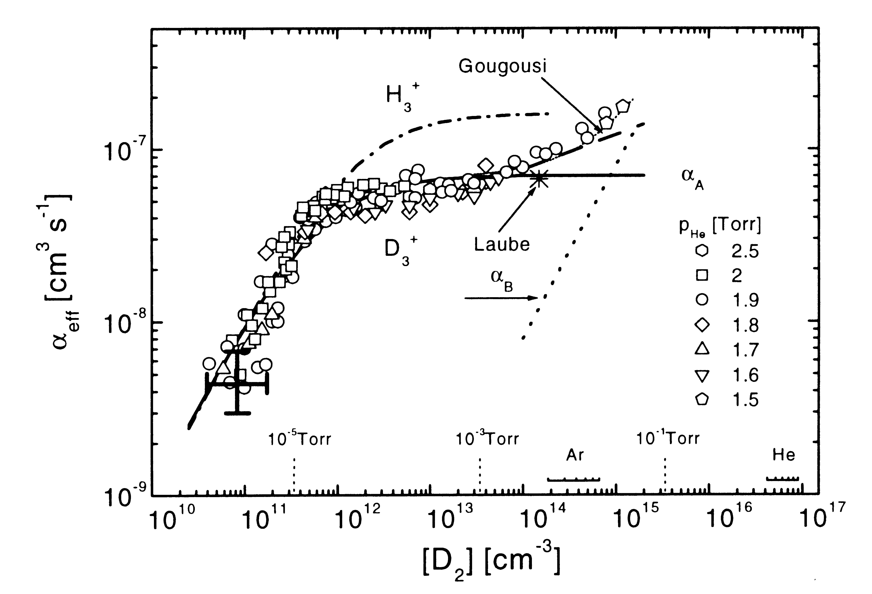
Glosik et al, from the 2001 Chicago meeting

Slide 8
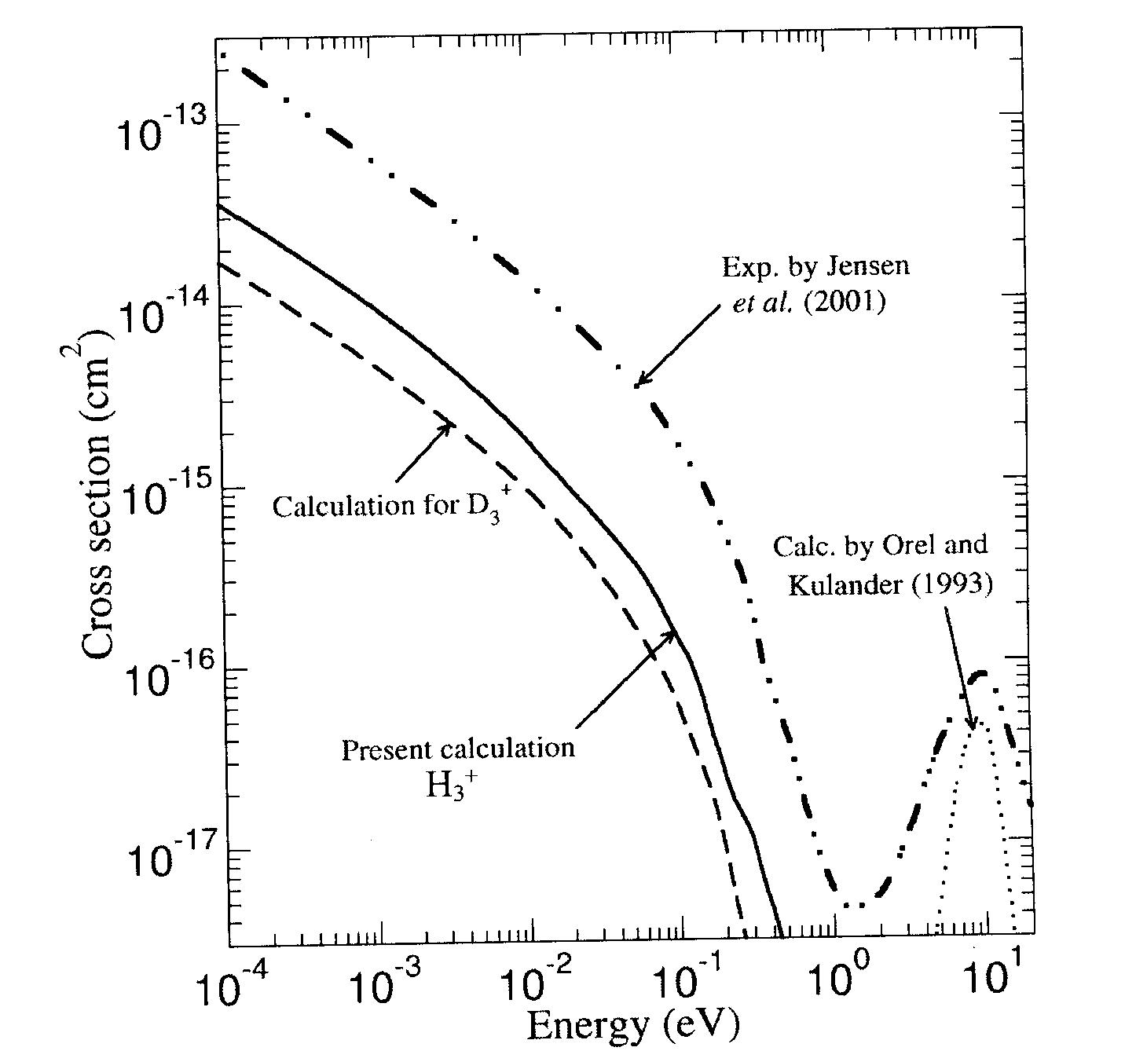
Greene and Kokoouline, Chicago 2001

Slide 9
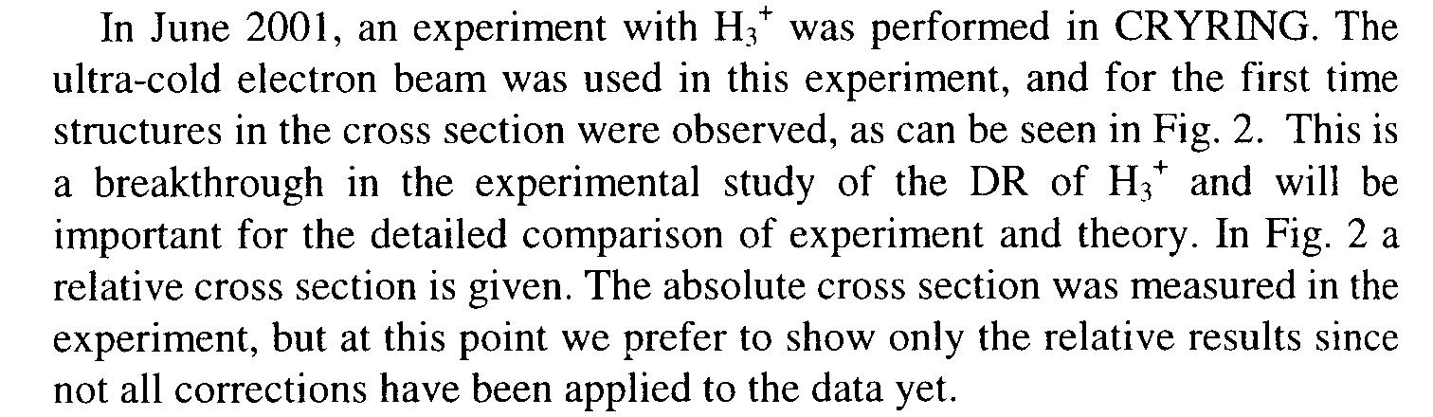
Larsson, Chicago meeting 2001
But I was wrong!

Slide 10
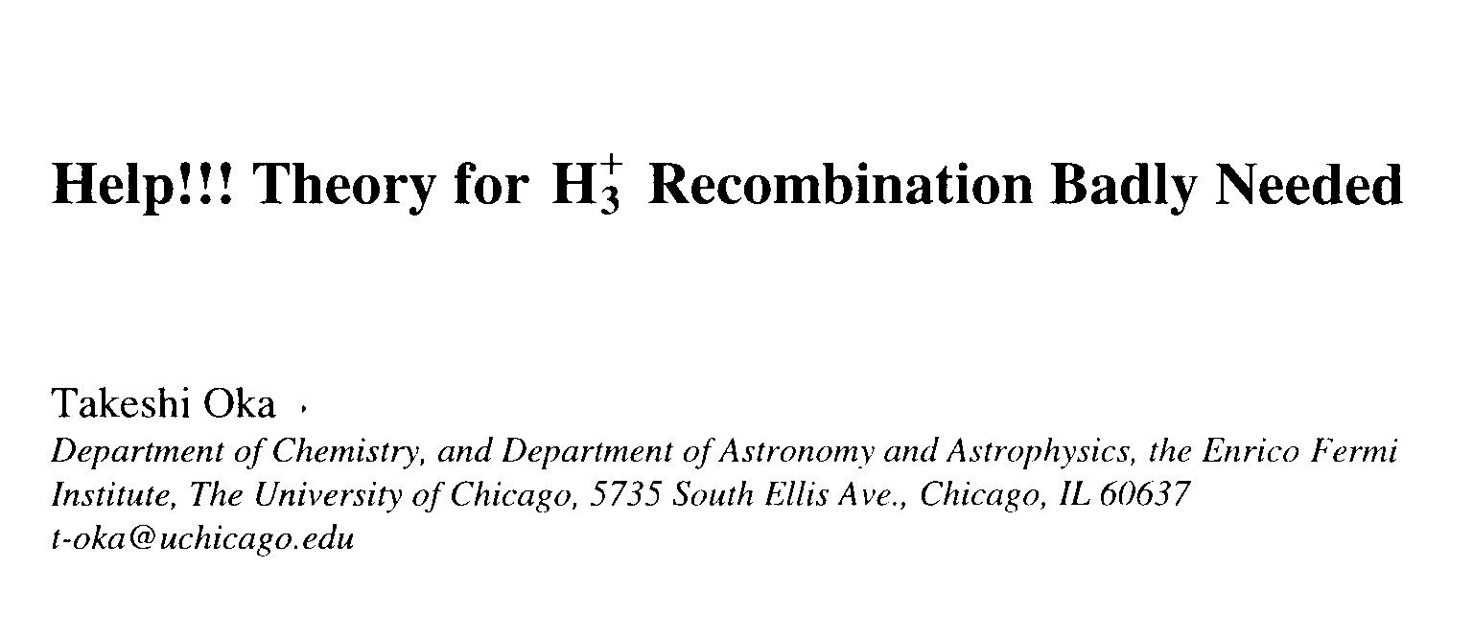
Oka, Chicago meeting 2001

Slide 11
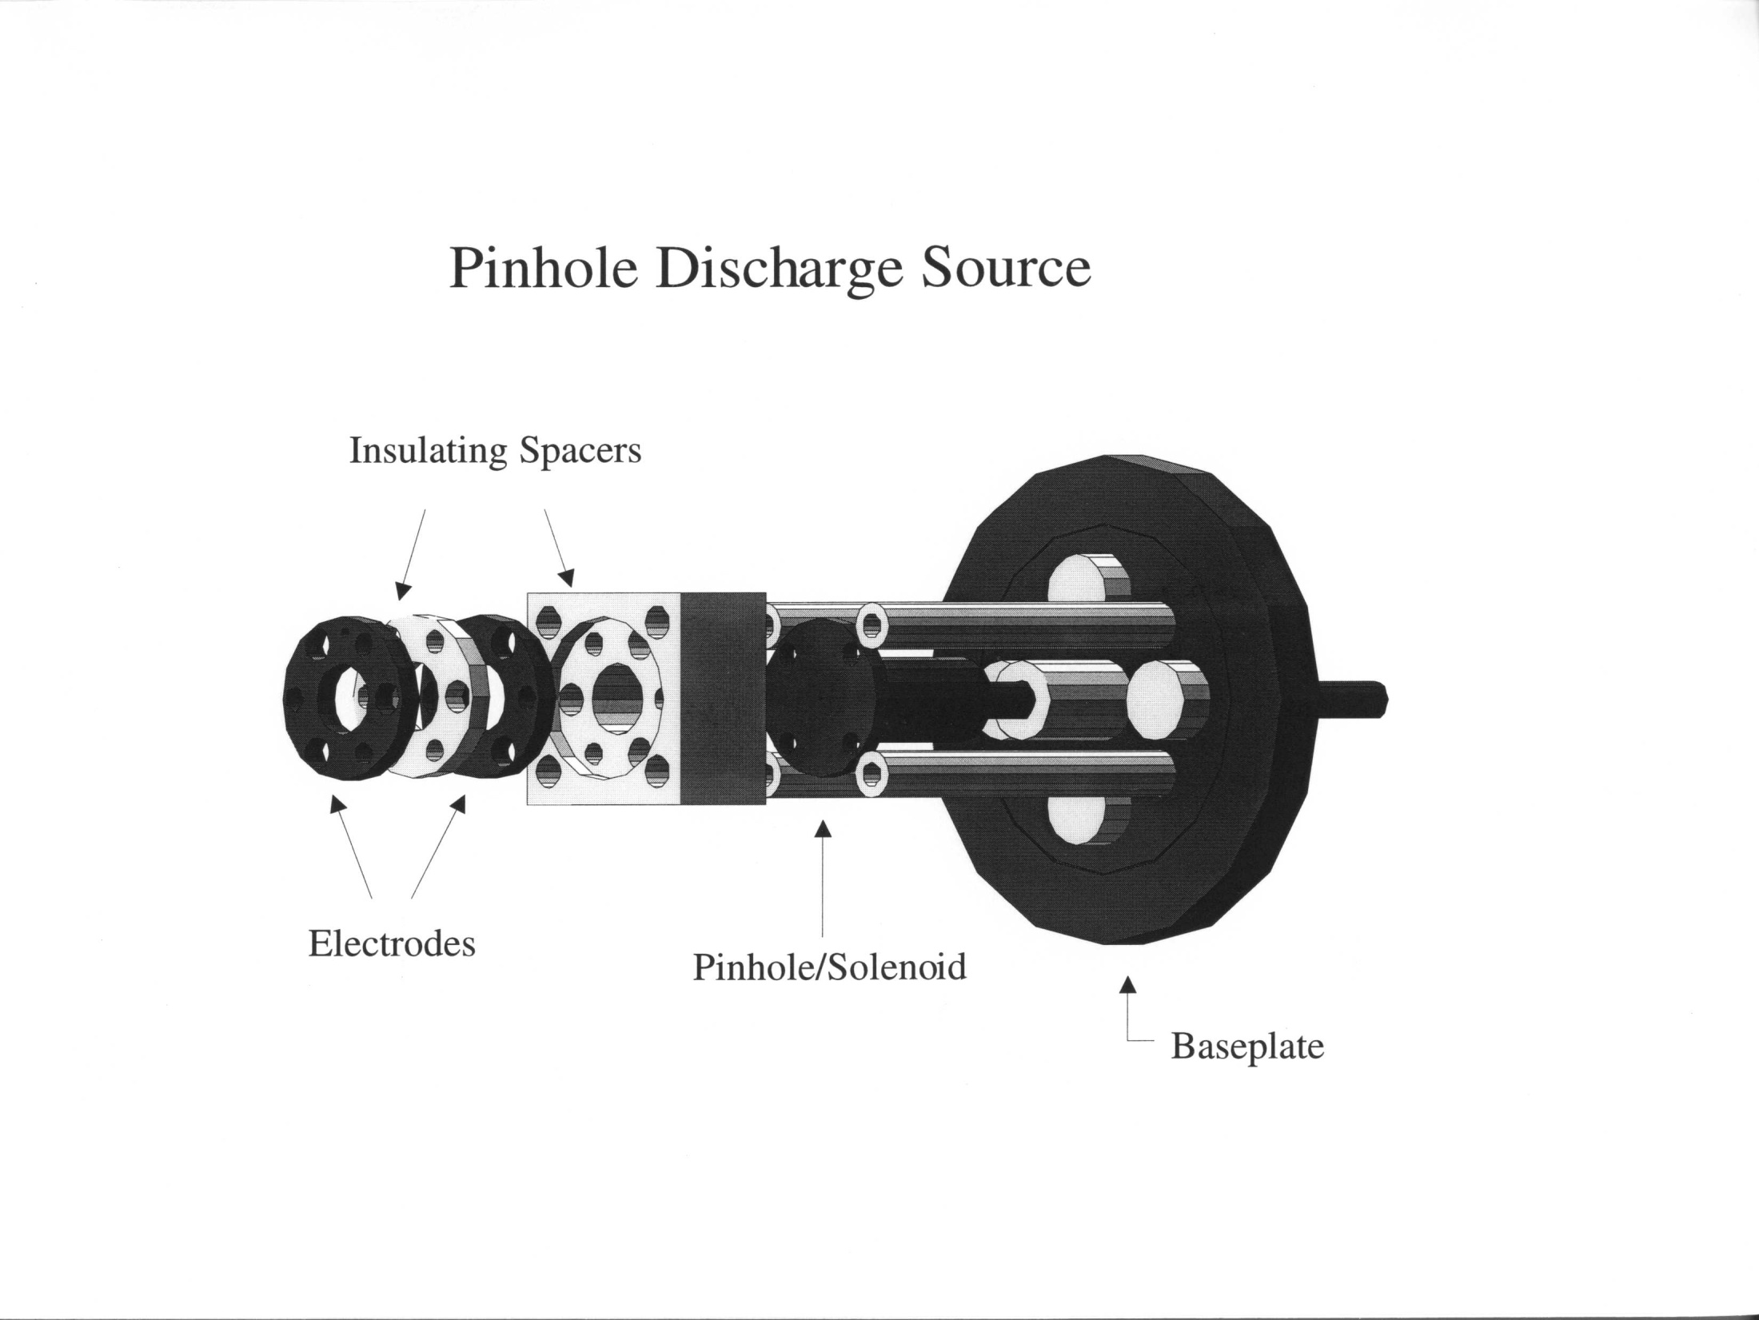

Slide 12
Strategy for new experiments (June and September 2002) at CRYRING
Use an ion source that delivers rotationally cold H₃⁺ ions
A pinhole discharge ion source was built in Saykally’s group at UC Berkeley
The source was characterized by means of their IR cavity ring-down spectrometer
The source was shipped to Stockholm and connected to CRYRING

Slide 13
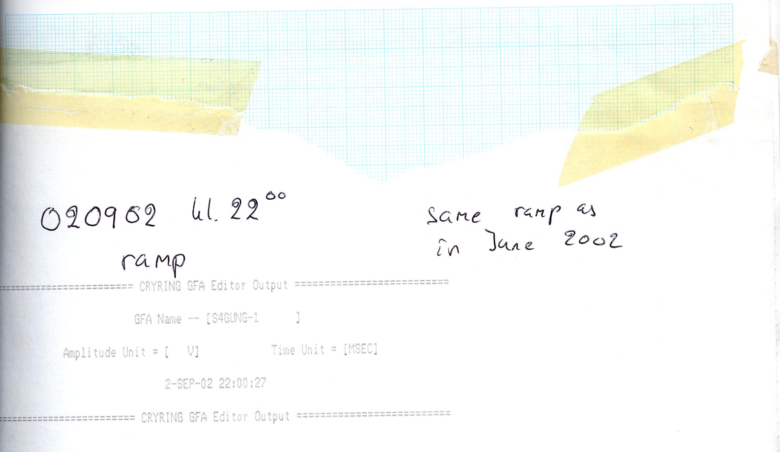
CRYRING log book
Monday, 2 September 2002

Slide 14
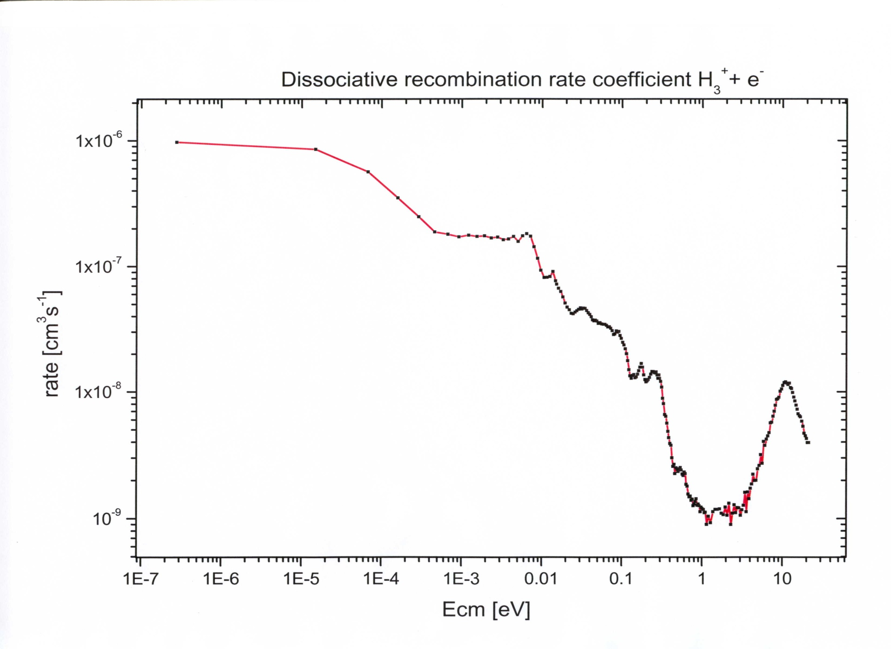
McCall, et al. including Larsson & Thomas, Nature 2003

Slide 15
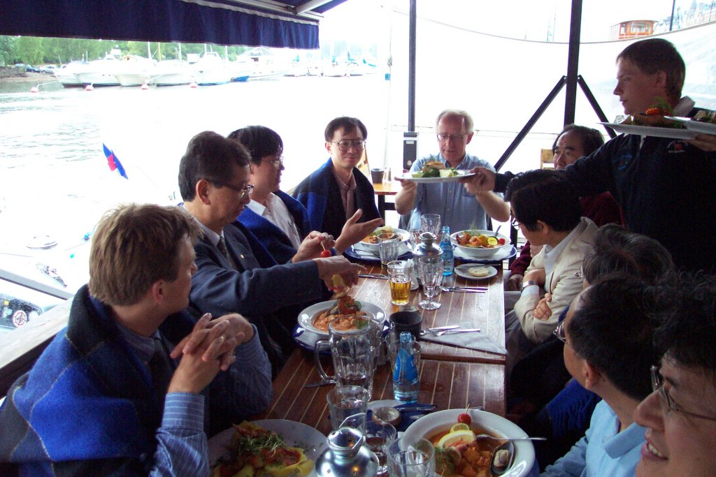
Dinner after workshop in Stockholm, June 13, 2002

Slide 16
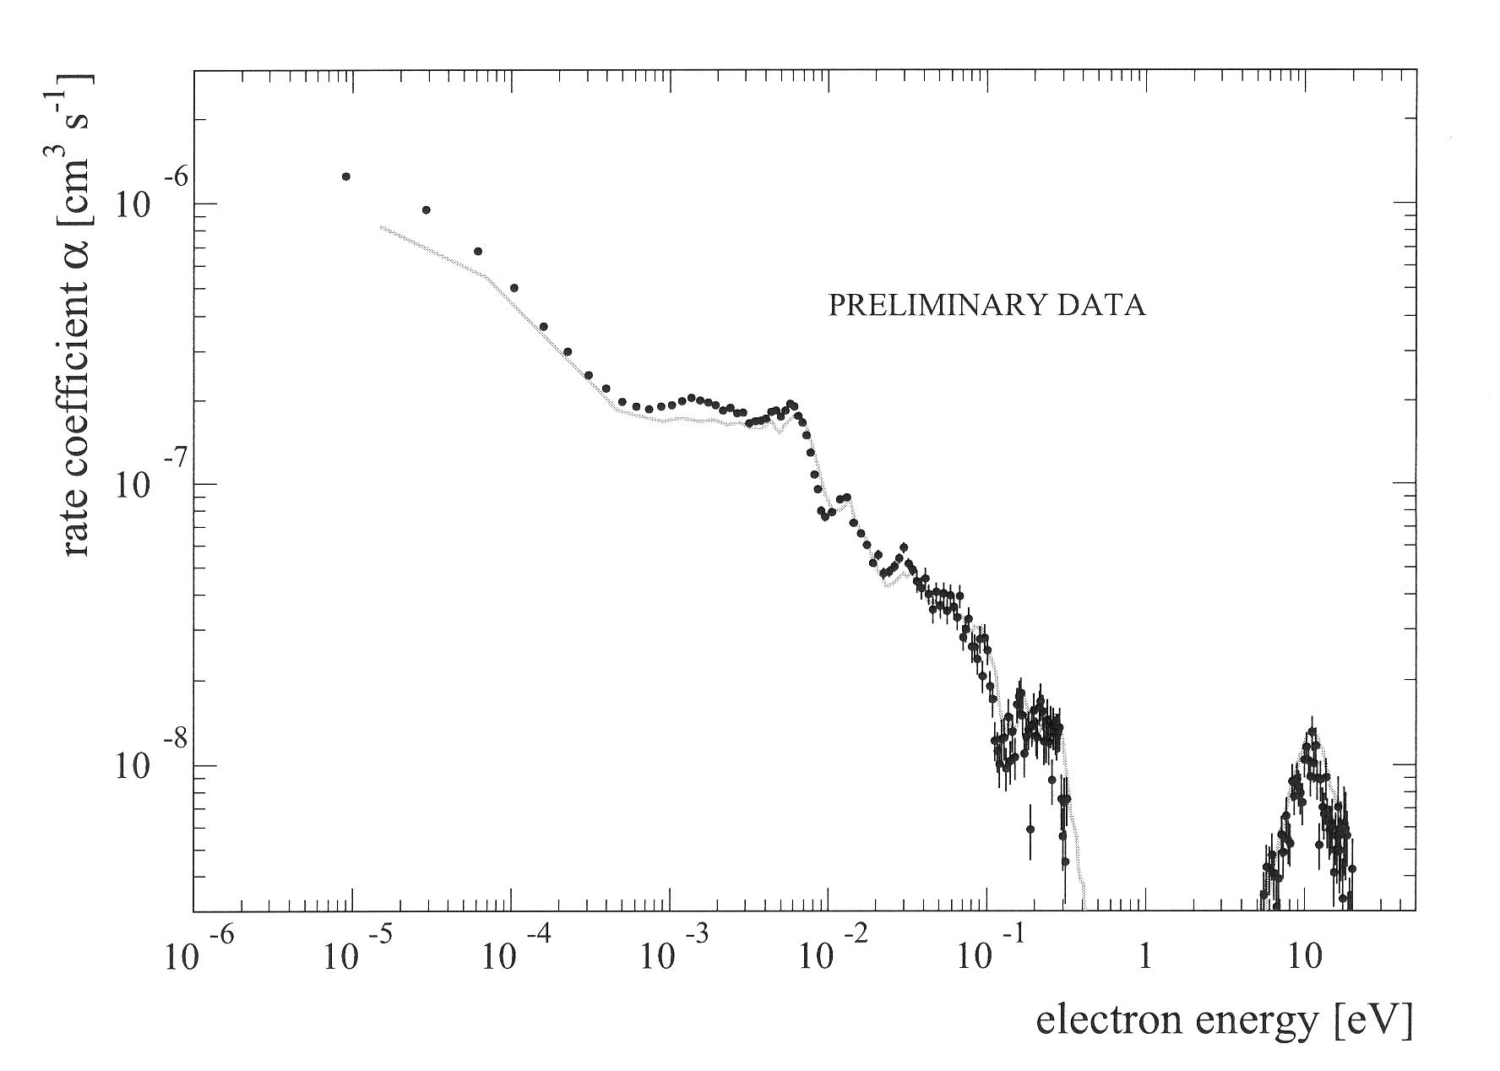
December 17, 2004
Dear Holger,
Congratulations to the H3+ results. I know you have put a lot of efforts into building the source and getting it to work connected to the TSR. The agreement is amazing!
Happy Holidays!
Mats

Slide 17
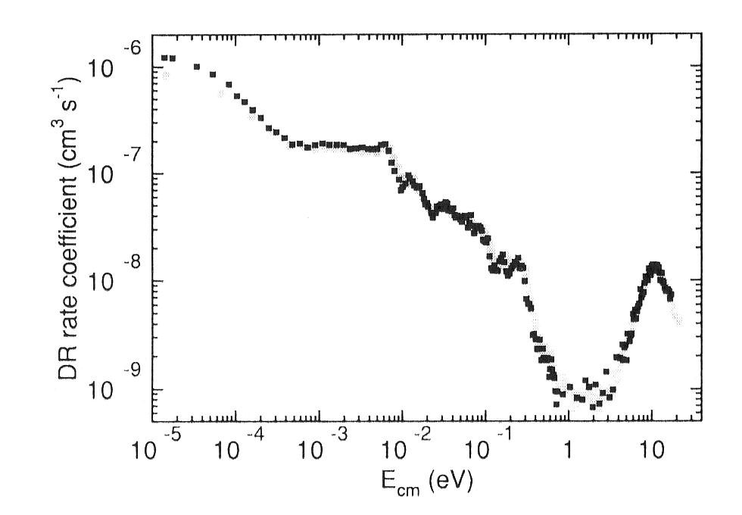
Kreckel et al. 2010, comparison TSR/CRYRING

Slide 18
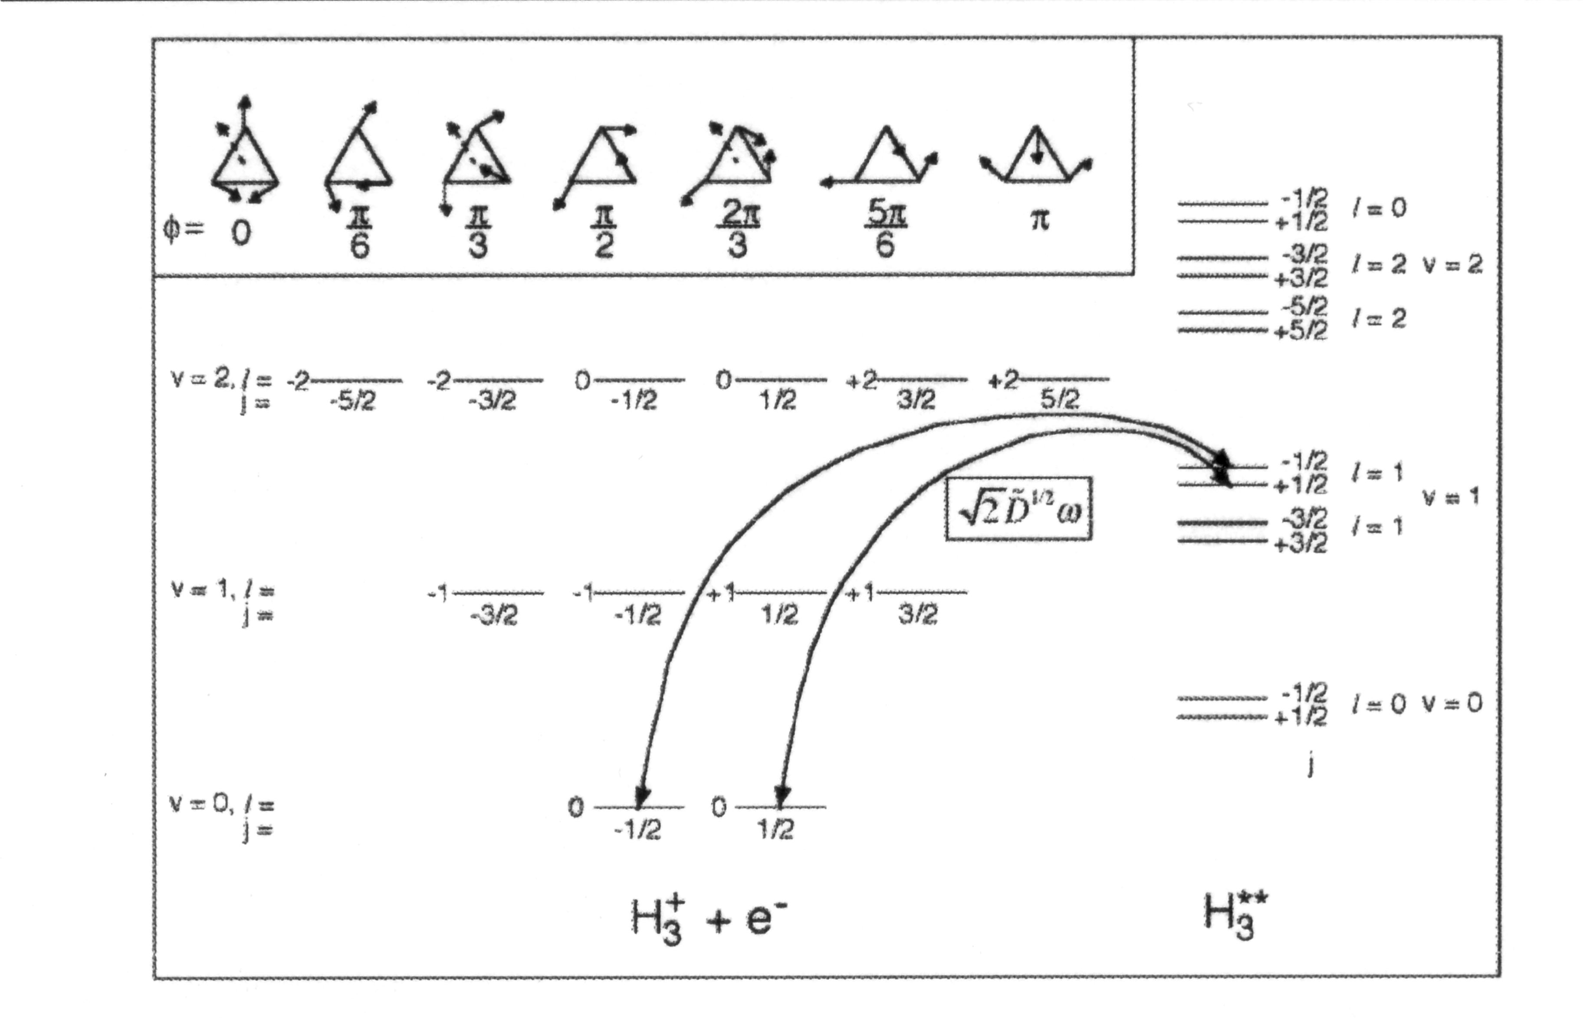
Jungen & Pratt 2009

Slide 19
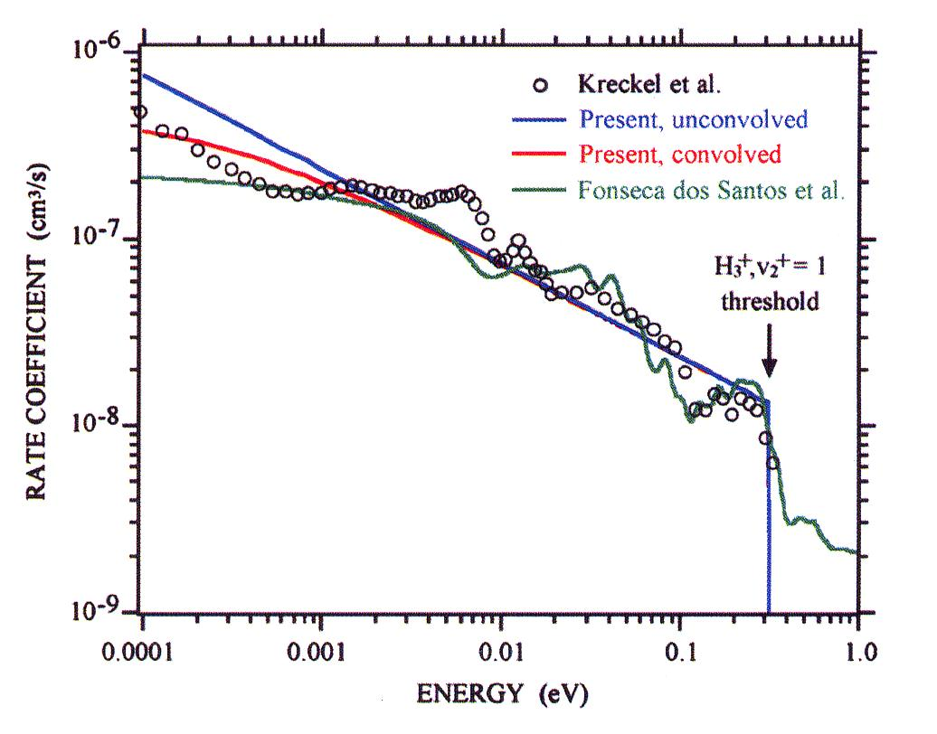
Jungen & Pratt 2009

Slide 20
Outstanding questions
It now seems clear that the plasma afteglow results are consistent with the storage ring results, but the issue is far from exhausted. (Juraj Glosik and Rainer Johnsen will discuss plasma experiments on Saturday)
There are still departures between storage ring experiments and theory concerning the finer details (previous talk by Holger Kreckel)
The agreement between experiment and theory (Kokoouline&Greene) for D₂H⁺ is not yet satisfactory

Slide 21
Outlook
It will be very interesting to follow the first experiments on H₃⁺ in the Cryogenic Storage Ring (CSR) in Heidelberg

